Slide 1
Processes and Threads
Da-Wei Chang
CSIE.NCKU
Source: Abraham Silberschatz, Peter B. Galvin, and Greg Gagne, "Operating System Concepts", 9th Edition, Wiley.

Slide 2
Process(程序) Concept
Process – a program in execution(執行檔執行後就是一個process)
A process includes
  text (i.e., code section)
  heap
  stack
  data section
  program counter and the content of the processor registers
Program – passive ; Process – active

Slide 3

A Process in Memory
More than one processes can be associated with the same program

Slide 4
Process State
As a process executes, it changes its state
  new: The process is being created
  ready: The process is waiting to be assigned to a CPU
    The process is runnable
  running: Instructions are being executed (i.e. owns the CPU)
  waiting: The process is waiting for some event to occur
  terminated: The process has finished execution

Slide 5

Diagram of Process State
Each process has its own process state diagram!!!

Slide 6
Process Control Block (PCB)
Information associated with each process
Process state
Program counter (PC) & the other CPU registers
  PC: the address of the next instruction
  The other registers: depending on the processor architecture
    Accumulators, index registers, stack pointers, general purpose registers…
  Must be saved when an interrupt occurs
CPU scheduling information
  Priority, pointers to scheduling queues, other scheduling parameters…

Slide 7
Process Control Block (PCB)
Information associated with each process (cont.)
Memory-management information
  List of memory sections
  Physical memory size
Accounting & identification information
  CPU time and real time used
  Time limits
  Process ID
I/O status information
  Open files and devices…

Slide 8

Process Control Block (PCB)
Also called Task Control Block (TCB)
task_struct in Linux: /include/linux/sched.h

Slide 9
Context Switch
When CPU switches to another process, the system must save the state of the old process in its PCB and load the saved state for the new process
  This is called context switch
Context-switch time is overhead; the system does no useful work while switching
  Typically, context switch requires a few microseconds

Slide 10

CPU Switch from Process to Process

Slide 11
Operations on Processes
We introduce two operations here
  Creation
  Termination

Slide 12

Process Creation
Parent process create children processes, which, in turn create other processes, forming a tree of processes

Slide 13
Process Creation (Cont.)
Process creation in UNIX
  fork system call creates new process
  exec system call
    replace the process’ memory space with a new program
    usually used after a fork

Slide 14
Ref: C Program Forking
Another Process
int main()
{
pid_t pid, dead;
int status;
/* fork another process */
pid = fork();
if (pid < 0) { /* error occurred */
fprintf(stderr, "Fork Failed");
exit(-1);
}
else if (pid == 0) { /* child process */
execlp("/bin/ls", "ls", NULL);
}
else { /* parent process */ // pid == child’s pid
/* parent will wait for the child to complete */
dead = wait (&status); // dead == the pid of the child that has died
printf ("Child Complete");
exit(0);
}
}

Slide 15

Execution Flow of the Program

Slide 16
Process Termination
Process executes last statement and asks the operating system to delete it (exit)
  Output data/status to its parent (via wait)
  Process’ resources are deallocated by operating system
Ref: If parent is exiting
  Some operating system (such as VMS) do not allow child to continue if its parent terminates
    All children terminated - cascading termination
  In UNIX, cascading termination is not required
    Child’s parent is set to the init process

Slide 17

Single and Multithreaded Processes

Slide 18
Threads
A lot of software packages are multi-threaded
  Web browser
    One thread displays images/text
    Another retrieves data from the network
  Word processor
    Display graphics
    Respond to keystrokes
    Perform spelling and grammar checking in the background
  Web server
    May have one thread for each request

Slide 19
Threads
If a web server is single-threaded
  Serve only one client at a time
  If it processes the requests one-by-one➔ a long waiting time
Multi-process solution
  Common before threads become popular
  Process creation is time consuming and resource intensive
Multi-threaded solution
  More efficient
    Threads are lightweight
A multi-threaded web server may
  Use a thread for listening for client requests
  Create a thread for each request

Slide 20
Benefits of Multi-Threading
Responsiveness
  Allows a program to continue running even if part of it is blocked
    E.g., a web browser allows user interaction while loading the text/image
Utilization of MP Architectures
  Threads can run in parallel on different processors
  Allows a MT application to run on top of multiple processors
Resource Sharing
  Threads share memory & resources
  Lightweight communication through memory sharing
Economy
  More economic to create/switch threads
  In Solaris, process creation is 32x slower, process switching is 5x slower
The former two also apply to multi-process architectures, while the latter two are more specific to multi-threading.

Slide 21
Pthreads
POSIX threads
  A specification for thread behavior (IEEE 1003.1c)
    Not an implementation
  OS designers can implement the specification
  Numbers of implementations in
    Solaris, Linux, Mac OS X, Tru64 UNIX
  Shareware implementations in Windows
A Pthreads example (see next two slides)
  A thread begins with main()
  Main() creates a second thread by pthread_create()
  Both threads share the global variable sum
  Wait for a thread to terminate by pthread_join()

Slide 22

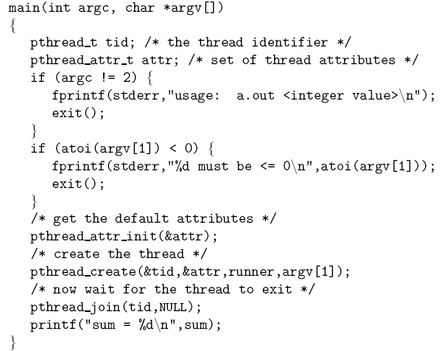
A Pthreads Example

Slide 23
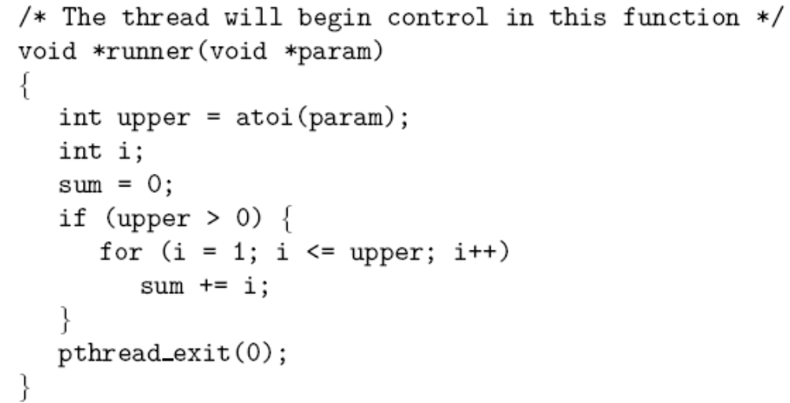
A Pthreads Example (cont.)

Slide 24
CPU Scheduler
Selects among the processes in memory that are ready to execute, and allocates the CPU to one of them
CPU scheduling decisions may take place when a process:
  1. Switches from running to waiting state (IO, wait for child)
  2. Switches from running to ready state (time expire)
  3. Switches from waiting to ready (IO completion)
  4. Terminates

Slide 25
Non-preemptive vs.
Preemptive Scheduling
Non-preemptive Scheduling/Cooperative Scheduling
  Scheduling takes place only under circumstances 1 and 4
    Process holds the CPU until termination or waiting for IO
  Examples: MS Windows 3.1; Mac OS (before Mac OS X)
Preemptive Scheduling
  Scheduling takes place under all the circumstances (1 to 4)
  Better for time-sharing system and real-time systems
  Usually, more context switches
  A cost associated with shared data access
    May be preempted in an unsafe point

Slide 26
Scheduling Algorithms –
Selecting the Next Process
FCFS(先來先選)
SJF
Priority-based
RR
Multi-Level Queue
Multi-Level Feedback Queue

Slide 27
First-Come, First-Served (FCFS) Scheduling
Process Burst Time ⬅ CPU burst
P₁ 24
P₂ 3
P₃ 3
Implemented via a FIFO (first-in first-out) queue
Suppose that the processes arrive (at time 0) in the order: P₁ , P₂ , P₃
The Gantt Chart for the schedule is:
Waiting time for P₁ = 0; P₂ = 24; P₃ = 27
Average waiting time: (0 + 24 + 27)/3 = 17
P₁
P₂
P₃
0
24
27
30

Slide 28
FCFS Scheduling (Cont.)
Suppose that the processes arrive in the order
P₂ , P₃ , P₁
The Gantt chart for the schedule is:
Waiting time for P₁ = 6; P₂ = 0; P₃ = 3
Average waiting time: (6 + 0 + 3)/3 = 3
Much better than previous case
P₂
P₃
P₁
0
3
6
30

Slide 29
FCFS Scheduling (Cont.)
Convoy effect
  Short process behind long process
  Multiple IO bound process may wait for a single CPU bound process
    Device idle….
FCFS is non-preemptive
  Not good for time-sharing systems

Slide 30
Shortest-Job-First (SJF)
Scheduling
Associate with each process the length of its next CPU burst, and select the process with the shortest burst to run
Two schemes:
  nonpreemptive – once the CPU is given to a process, it cannot be preempted until the completion of the CPU burst
  preemptive – if a new process arrives with CPU burst length less than remaining time of current executing process, preempt the current process.
    known as the Shortest-Remaining-Time-First (SRTF) scheduling
SJF is optimal – gives minimum average waiting time for a given set of processes

Slide 31
Example of Non-Preemptive SJF
Process Arrival Time Burst Time
P₁ 0.0 7
P₂ 2.0 4
P₃ 4.0 1
P₄ 5.0 4
SJF (non-preemptive)
Average waiting time = (0 + 6 + 3 + 7)/4 = 4
P₁
P₃
P₂
P₄
0
3
7
8
12
16

Slide 32
Example of Preemptive SJF
Process Arrival Time Burst Time
P₁ 0.0 7
P₂ 2.0 4
P₃ 4.0 1
P₄ 5.0 4
SJF (preemptive)
Average waiting time = (9 + 1 + 0 +2)/4 = 3
P₁
P₂
P₃
P₂
P₄
P₁
0
2
4
5
7
11
16

Slide 33
Ref: SJF Scheduling
How to know the length of the next CPU burst?
  Difficult…..
  For long term job scheduling
    User can specify the burst/execution time
    shorter burst time ➔ higher priority
    If the specified burst time is too short
      Time limit expires ➔ user has to resubmit the job
  For short term scheduling
    There is no way to know the length of the next CPU burst
    So, predict it ….

Slide 34
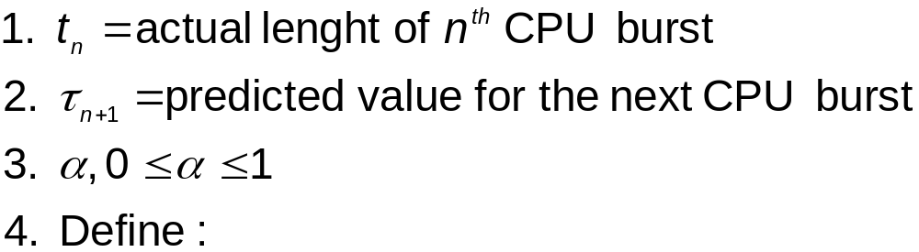

Ref: Predicting Length of Next CPU Burst
Can only estimate the length
Can be done by using the length of previous CPU bursts, using exponential averaging

Slide 35

Ref: Predicting Length of the Next
CPU Burst
τ0 = 10
α = 1/2

Slide 36
Ref: Examples of Exponential Averaging
α =0
  τ_{n+1} = τ_{n}
  Recent history does not count
α =1
  τ_{n+1} = α t_{n}
  Only the actual last CPU burst counts
If we expand the formula, we get:
    τ_{n+1} = α t_{n}+(1 - α)α t_{n} ₋₁ + …
    +(1 - α )^{j} α t_{n} _{-j} + …
    +(1 - α )^{n +1} τ₀
Since both α and (1 - α) are less than or equal to 1, each successive term has less weight than its predecessor

Slide 37
Priority Scheduling
A priority number (integer) is associated with each process
The CPU is allocated to the process with the highest priority ( in many systems, smallest integer ➔ highest priority)
  Preemptive
  Non-preemptive
SJF is a priority scheduling where priority is the predicted next CPU burst time
Problem : Starvation – low priority processes may never execute
  A low priority process submitted in 1967 had not been run when the system IBM 7094 at MIT was shutdown in 1973
Solution : Aging – as time progresses increase the priority of the process

Slide 38
Priority Scheduling
Process Burst Time Priority
P₁ 10 3
P₂ 1 1
P₃ 2 4
P₄ 1 5
P₅ 5 2
Execution Sequence: P2, P5, P1, P3, P4

Slide 39
Round Robin (RR)
Each process gets a small unit of CPU time (time quantum), usually 10-100 milliseconds. After this time has elapsed, the process is preempted and added to the end of the ready queue.
A process will leave the running state if
  Time quantum expire
  Wait IO or events
If there are n processes in the ready queue and the time quantum is q, then each process gets 1/n of the CPU time in chunks of at most q time units at once. No process waits more than (n-1)q time units.
RR is preemptive

Slide 40
Example of RR with
Time Quantum = 20
Process Burst Time
P₁ 53
P₂ 17
P₃ 68
P₄ 24
The Gantt chart is:
Typically, higher average turnaround than SJF, but better response time
P₁
P₂
P₃
P₄
P₁
P₃
P₄
P₁
P₃
P₃
0
20
37
57
77
97
117
121
134
154
162

Slide 41

Ref: Time Quantum and Context Switch Time
Performance
  q large ⇒ FIFO
  q small ⇒ q must be large with respect to context switch, otherwise overhead is too high
Context switches are not free!!!

Slide 42

Ref: Turnaround Time Varies with the Time Quantum
Given 3 processes of 10 time units
for quantum of 1 time unit ➔ average turnaround time = 29
for quantum of 10 time unit ➔ average turnaround time = 20
Rule of thumb: 80% of the CPU bursts should be shorter than the time quantum

Slide 43
Multilevel Queue
Used when processes are easily classified into different groups
Ready queue is partitioned into separate queues
  E.g., foreground (interactive) and background (batch)
    These two types of processes have different response time requirements
    FG processes can have priority over BG processes
A process is fixed on one queue
Each queue has its own scheduling algorithm
  E.g., foreground – RR; background – FCFS

Slide 44

Multilevel Queue Scheduling

Slide 45
Multilevel Queue
Scheduling must be done between the queues
  Fixed priority scheduling
    i.e., serve all from foreground then from background
    possibility of starvation
  Time slicing
    each queue gets a certain amount of CPU time which it can schedule amongst its processes
    i.e., 80% to foreground in RR, 20% to background in FCFS

Slide 46
Multilevel Feedback Queue
A process can move among different queues
The idea
  Separate processes according to the characteristics of their CPU bursts
    Use too much CPU time ➔ move to a lower priority Q
      Favor interactive and IO bound processes
    Wait too long in a low priority Q ➔ move to a higher priority Q
      aging

Slide 47
Example of Multilevel Feedback Queue
Three queues
  Q₀ – RR with time quantum 8 ms
  Q₁ – RR time quantum 16 ms
  Q₂ – FCFS
Scheduling
  A new job enters queue Q₀. When it gains CPU, job receives 8 ms. If it does not finish its current burst in 8 ms, job is preempted and moved to queue Q₁.
  At Q₁ job is again served and receives 16 ms. If it still does not complete its burst, it is preempted and moved to queue Q₂.

Slide 48

Multilevel Feedback Queues
Give highest priority to processes with CPU burst <= 8ms

Slide 49
Multilevel Feedback Queues
Multilevel-feedback-queue scheduler defined by the following parameters:
  number of queues
  scheduling algorithms for each queue
  method used to determine when to promote a process
  method used to determine when to demote a process
  method used to determine which queue a process will enter when that process needs service
It is the most generic algorithm
  Can be configured to match a specific system
It is the most complex algorithm
  You have to select a proper value for each parameter

